Slide 1


Raine Conor
February 27, 2025

Slide 2

Outline
Executive Summary
Introduction
Methodology
Results
Conclusion
Appendix

Slide 3
Executive Summary
Summary of methodologies
Data collection and wrangling
Exploratory data analysis (EDA)
Visualization
Prediction using machine learning
Summary of all results
Using exclusively public data, we discovered which features correlate with the success or failure of a launch
After testing several algorithms, it was discovered that decision tree outperformed the others, with a final accuracy of 83.33%

Slide 4
Introduction
SpaceX advertises Falcon 9 rocket launches on its website with a cost of 62 million dollars whereas other providers cost upward of 165 million dollars each, much of the savings is because Space X can reuse the first stage. Therefore if we can determine if the first stage will land, we can determine the cost of a launch. This information can be used if an alternate company wants to bid against SpaceX for a rocket launch.
The goal of this analysis is to determine which, if any, features from the public data sets can be used to predict if a landing will be successful or not.

Slide 5

Section 1

Slide 6
Methodology
Executive Summary
Data collection methodology:
SpaceX API and web scraping from Wikipedia
Perform data wrangling
Identified which columns had missing values, created labels from the outcome column
Perform exploratory data analysis (EDA) using visualization and SQL
Perform interactive visual analytics using Folium and Plotly Dash
Perform predictive analysis using classification models
Standardize the data, find the best hyperparameters using GridSearchCV, and compare the results from each model by accuracy

Slide 7
Data Collection
First data set was fetched from the SpaceX API using python
Second data set was scraped from Wikipedia using python

Slide 8
Data Collection – SpaceX API
Request data from SpaceX API
Convert JSON response into a dataframe
Impute missing values
https://github.com/raineconor/ibm-data-science/blob/master/Applied Data Science Capstone/1_ jupyter-labs-spacex-data-collection-api.ipynb

Slide 9
Data Collection - Scraping
Request data from Wikipedia
Create a BeautifulSoup object from the HTML response
Extract the data from the desired table and convert to a dataframe
https://github.com/raineconor/ibm-data-science/blob/master/Applied Data Science Capstone/2_ jupyter-labs-webscraping.ipynb

Slide 10
Data Wrangling
Import from CSV
Examine the data
Create a new column
Imported data from CSV into a dataframe, discovered which columns have missing values, created a new column “Class” describing the success of each launch
https://github.com/raineconor/ibm-data-science/blob/master/Applied Data Science Capstone/3_ labs-jupyter-spacex-Data wrangling.ipynb

Slide 11
EDA with Data Visualization
Plotted several scatter plots to get familiar with what features correlate with successful launches, and a bar chart to compare success rates
https://github.com/raineconor/ibm-data-science/blob/master/Applied Data Science Capstone/5_ edadataviz.ipynb

Slide 12
EDA with SQL
Performed the following SQL queries:
Selected distinct names of launch sites
Selected first 5 launch sites beginning with 'CCA’
Selected sum of payload mass carried by NASA boosters
Selected average payload mass carried by booster version F9 v1.1
Selected the date of the first successful landing outcome in ground pad, using the min function
Selected the names of all boosters with success in drone ship and have payload mass between 4000 and 6000 kg
Selected the sum of both successful and failed missions
Selected names of the booster versions which carried the maximum payload mass, using a subquery
Selected the month names of failures from 3 columns in the year of 2015
Ranked the count of landing outcomes between the date 2010-06-04 and 2017-03-20 in descending order
https://github.com/raineconor/ibm-data-science/blob/master/Applied Data Science Capstone/4_ jupyter-labs-eda-sql-coursera_sqllite.ipynb

Slide 13
Build an Interactive Map with Folium
Visualize Launch Sites: Using folium.Circle and folium.map.Marker to mark the locations of launch sites.
Display Launch Outcomes: Using markers within folium.plugins.MarkerCluster to show the success or failure of individual launches at each site, using different colors for success (green) and failure (red).
Facilitate Proximity Analysis: Using folium.plugins.MousePosition to get coordinates of nearby features and folium.PolyLine to draw distance lines between launch sites and these features, enabling visual analysis of launch site proximities to coastlines, cities, railways, and highways.
Improve Map Clarity: Using folium.plugins.MarkerCluster to handle potentially overlapping markers and improve the map's readability, especially when zoomed out.
Provide Custom Labels: Using folium.features.DivIcon to create custom marker icons with text labels for better information display directly on the map.
https://github.com/raineconor/ibm-data-science/blob/master/Applied Data Science Capstone/6_ lab_jupyter_launch_site_location.ipynb

Slide 14
Build a Dashboard with Plotly Dash
Overall Success Rate: What is the general success rate of SpaceX launches? (Pie Chart - All Sites)
Site-Specific Success Rates: Do different launch sites have varying success rates? (Pie Chart - Site Selection)
Payload Mass Impact: Is there a correlation between the payload mass and launch success? (Scatter Chart - Payload vs. Success)
Payload Range Analysis: Does the success rate change for different payload mass ranges? (Scatter Chart + Range Slider)
Site and Payload Combined Analysis: How does the payload-success relationship vary across different launch sites? (Scatter Chart + Site Dropdown + Range Slider)
https://github.com/raineconor/ibm-data-science/blob/master/Applied Data Science Capstone/7_ spacex_dash_app.py

Slide 15
Predictive Analysis (Classification)
Standardize and split data
Train several models
Compare the results from each model
Choose 4 different classification models
Prepare the data using standardization and a train-test split
Optimize hyperparameters for each model using GridSearchCV with cross-validation
Evaluate the performance of the tuned models on unseen test data using accuracy and confusion matrices
Compare accuracies between models to identify the best performing one
https://github.com/raineconor/ibm-data-science/blob/master/Applied Data Science Capstone/8_ SpaceX_Machine Learning Prediction_Part_5.ipynb

Slide 16
Results
4 different launch sites were used
Average payload of F9 v1.1 booster is 2928 kg
2015 was the year of the first successful launch
Falcon 9 boosters were often successful at landing on drone ships even with an above average payload
Nearly all missions were successful
The F9 v1.1 B1012 and F9 v1.1 B1015 boosters failed when landing on drone ships in 2015
Success rate increased as time went on

Slide 17

Section 2

Slide 18
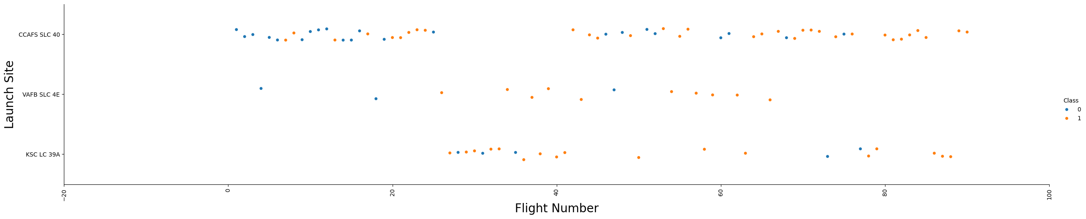
Flight Number vs. Launch Site
CCAFS SLC 40 was launched the most and became more successful over time
VAFB SLC 4E was launched the least
KSC LC 39A only had 5 total failures

Slide 19
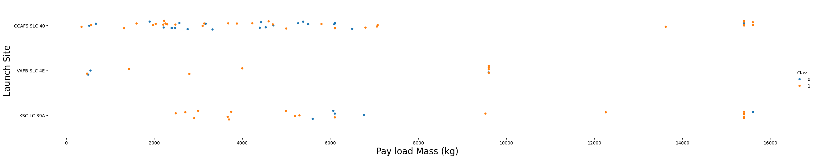
Payload vs. Launch Site
CCAFS SLC 40 and KSC LC 39A were the only sites used for payloads of 9000kg and above
Launches with payloads of 9000kg and above only had a total of 2 failures

Slide 20
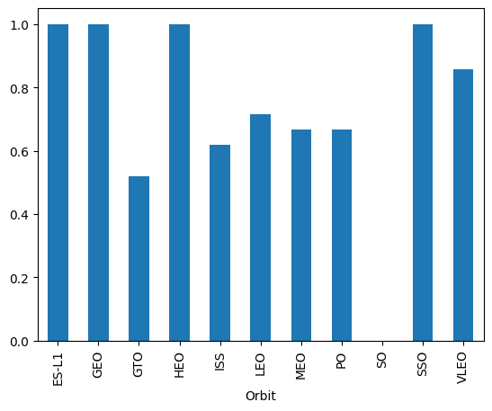
Success Rate vs. Orbit Type
ES-L1, GEO, HEO, and SSO have the highest success rates
SO has no success at all

Slide 21
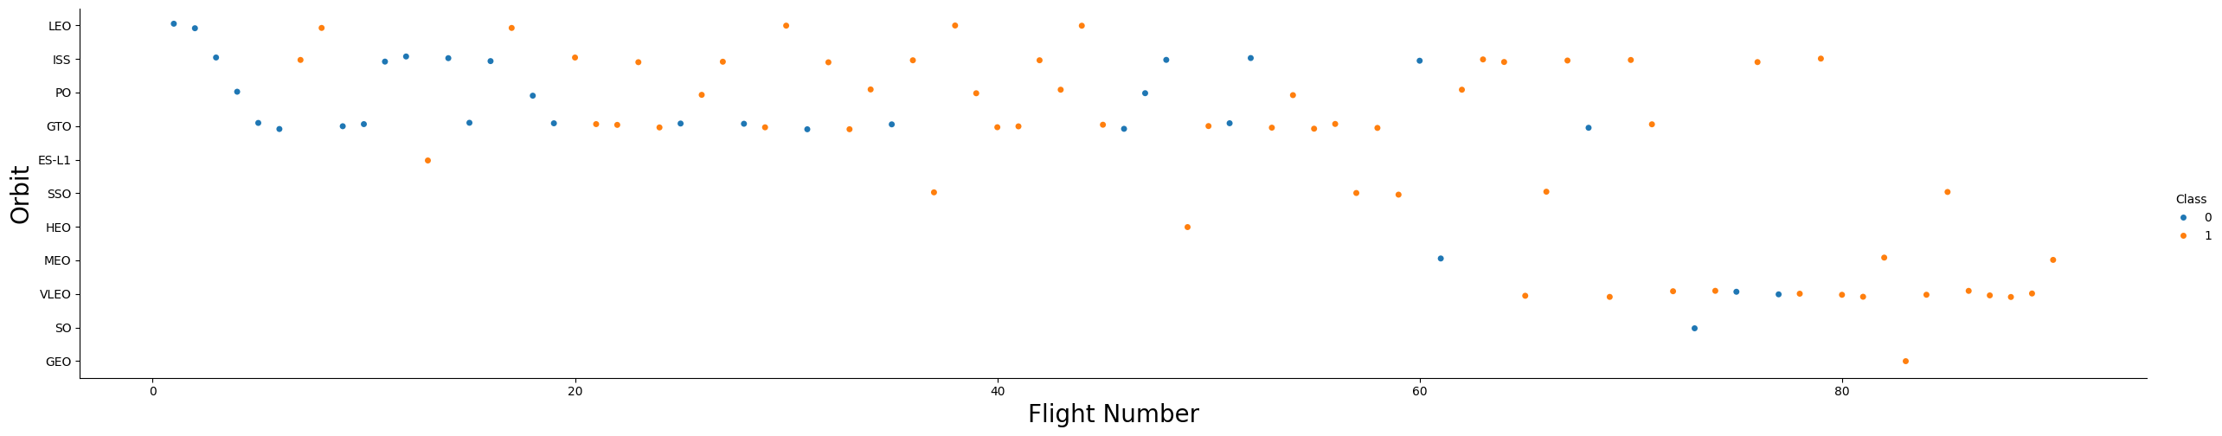
Flight Number vs. Orbit Type
Success rate increased as flight number increased
ISS and VLEO became the most common as flight number increased

Slide 22
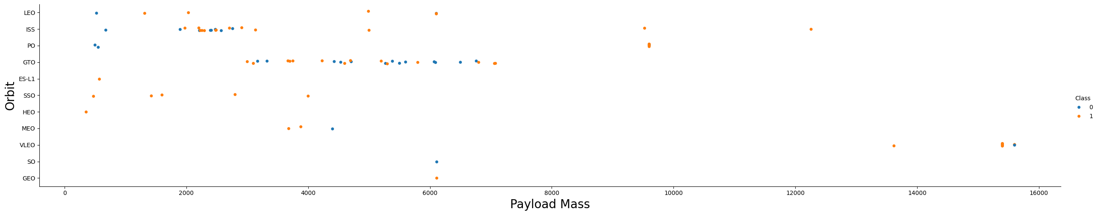
Payload vs. Orbit Type
GEO and SO are the least common orbit types
GTO is the most common orbit type
ISS, PO, and VLEO are the only orbits with payloads above 9000kg

Slide 23
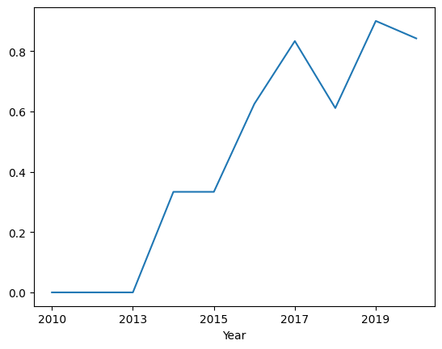
Launch Success Yearly Trend
Success increased steadily until 2017, where a drop occurred until 2018
The first 3 years suffered from no success

Slide 24
All Launch Site Names
CCAFS LC-40
VAFB SLC-4E
KSC LC-39A
CCAFS SLC-40
Site names were read from the database using SELECT DISTINCT

Slide 25
Launch Site Names Begin with 'CCA'
CCAFS LC-40 carried a variety of payloads successfully over the years 2010 to 2013, although all of the landings failed
Date | Time (UTC) | Booster_Version | Launch_Site | Payload | PAYLOAD_MASS__KG_ | Orbit | Customer | Mission_Outcome | Landing_Outcome
2010-06-04 | 18:45:00 | F9 v1.0 B0003 | CCAFS LC-40 | Dragon Spacecraft Qualification Unit | 0 | LEO | SpaceX | Success | Failure (parachute)
2010-12-08 | 15:43:00 | F9 v1.0 B0004 | CCAFS LC-40 | Dragon demo flight C1, two CubeSats, barrel of Brouere cheese | 0 | LEO (ISS) | NASA (COTS) NRO | Success | Failure (parachute)
2012-05-22 | 7:44:00 | F9 v1.0 B0005 | CCAFS LC-40 | Dragon demo flight C2 | 525 | LEO (ISS) | NASA (COTS) | Success | No attempt
2012-10-08 | 0:35:00 | F9 v1.0 B0006 | CCAFS LC-40 | SpaceX CRS-1 | 500 | LEO (ISS) | NASA (CRS) | Success | No attempt
2013-03-01 | 15:10:00 | F9 v1.0 B0007 | CCAFS LC-40 | SpaceX CRS-2 | 677 | LEO (ISS) | NASA (CRS) | Success | No attempt

Slide 26
Total Payload Mass
Read the total payload mass launched by NASA (CRS) using SELECT SUM, resulting in a total of 45596kg

Slide 27
Average Payload Mass by F9 v1.1
Calculated the average payload mass carried by booster version F9 v1.1 using SELECT AVG, resulting in an average of 2928.4kg

Slide 28
First Successful Ground Landing Date
Read the date of the first successful landing on ground pad using SELECT MIN, resulting in 2015-12-22

Slide 29
Successful Drone Ship Landing with Payload between 4000 and 6000
F9 FT B1022
F9 FT B1026
F9 FT B1021.2
F9 FT B1031.2
Read the names of boosters which have successfully landed on drone ship and had payload mass greater than 4000 but less than 6000 using SELECT DISTINCT and BETWEEN

Slide 30
Total Number of Successful and Failure Mission Outcomes
Read the successes and failures using SELECT, COUNT, and GROUP BY
Mission_Outcome | QTY
Failure (in flight) | 1
Success | 99
Success (payload status unclear) | 1

Slide 31
Boosters Carried Maximum Payload
Read the names of the boosters that carried the maximum payload mass using SELECT DISTINCT, MAX, and ORDER BY
F9 B5 B1048.4
F9 B5 B1048.5
F9 B5 B1049.4
F9 B5 B1049.5
F9 B5 B1049.7
F9 B5 B1051.3
F9 B5 B1051.4
F9 B5 B1051.6
F9 B5 B1056.4
F9 B5 B1058.3
F9 B5 B1060.2
F9 B5 B1060.3

Slide 32
2015 Launch Records
Read the failed launches for each month in 2015 using SELECT, and SUBSTR
Booster_Version | Launch_Site | MONTH
F9 v1.1 B1012 | CCAFS LC-40 | 01
F9 v1.1 B1015 | CCAFS LC-40 | 04

Slide 33
Rank Landing Outcomes Between 2010-06-04 and 2017-03-20
Ranked the count of landing outcomes between the 2010-06-04 and 2017-03-20, in descending order using SELECT, COUNT, DATE, and BETWEEN
Landing_Outcome | QTY
No attempt | 10
Success (drone ship) | 5
Failure (drone ship) | 5
Success (ground pad) | 3
Controlled (ocean) | 3
Uncontrolled (ocean) | 2
Failure (parachute) | 2
Precluded (drone ship) | 1

Slide 34

Section 3

Slide 35
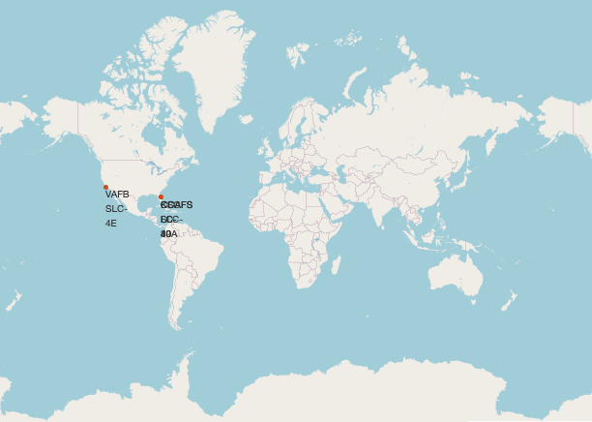
Launch Sites
All launch sites resided in the US, specifically in Florida and California

Slide 36
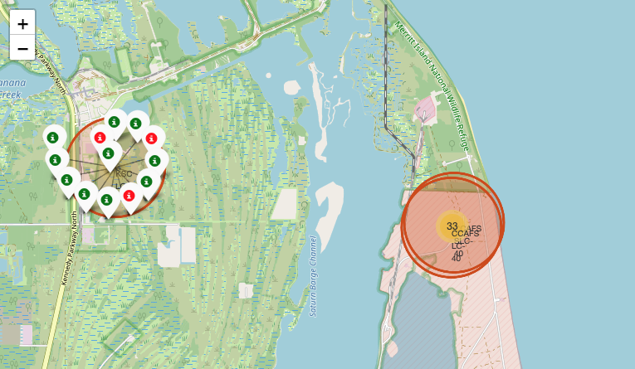
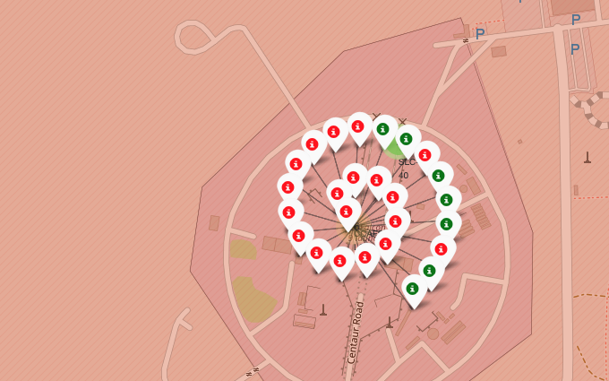
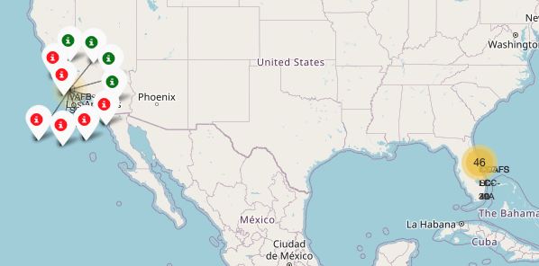
Outcomes at each Launch Site
Successful launches are distinguished from failed launches by color code, green being successful and red being failure
KSC LC-39A had the highest success percentage by individual site

Slide 37
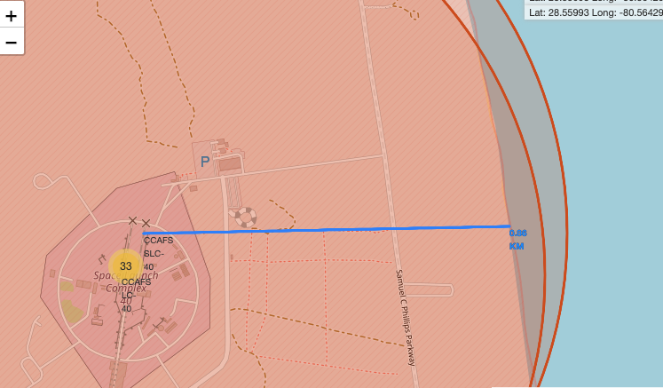
Proximity to Coastline
Launch site CCAFS SLC-40 is in close proximity to the coastline, at 0.86 km

Slide 38

Section 4

Slide 39
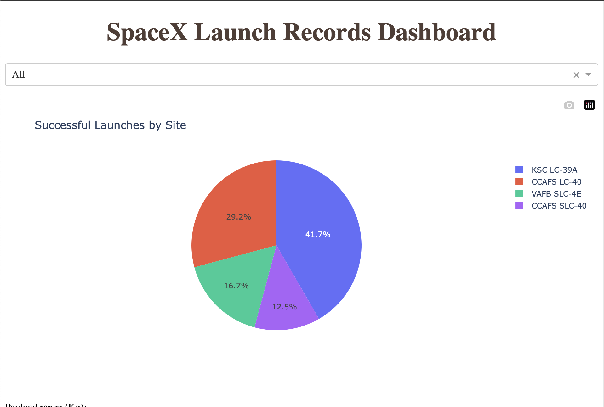
Successful Launches Per Site
There appears to be strong correlation between where a booster is launched from, and whether or not it is a successful

Slide 40
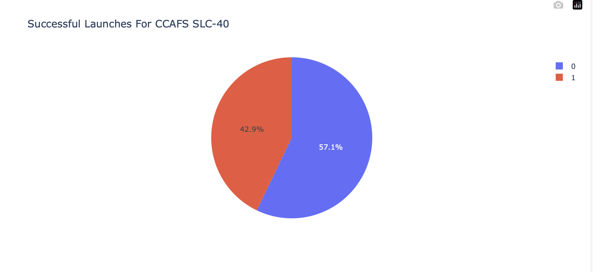
Highest Launch Success Ratio
CCAFS SLC-40 has the highest launch success ratio at 42.9%

Slide 41
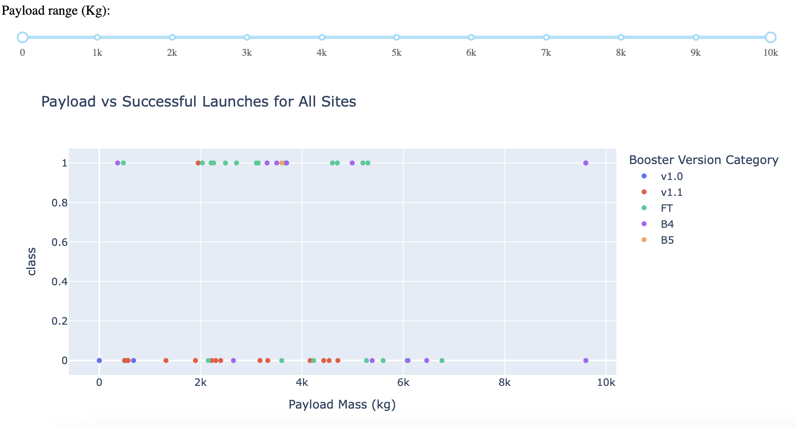
Payload Mass vs Success
Payloads between 2000kg and 5300kg have the highest density of successes
FT has the most successes in this range, v1.1 has the least

Slide 42

Section 5

Slide 43
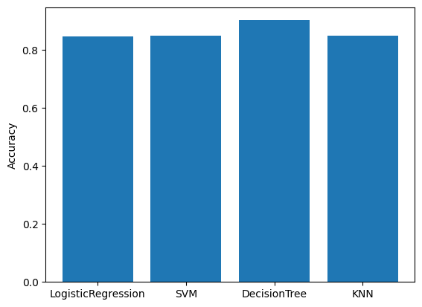
Classification Accuracy
Decision tree has the highest model accuracy at about 90%

Slide 44

Confusion Matrix
The true negatives and false negatives were equal, indicating a need for feature engineering or more data
All confusion matrices from the models were identical, supporting the previous argument
Having 0 false positives is a good attribute of the model

Slide 45
Conclusions
All model types performed similarly, with the decision tree outperforming by about 6% accuracy
CCAFS SLC-40 has the highest success rate
Successes seemed to improve over time
There is a strong correlation between payload mass and success

Slide 46


